Slide 1


TOUCH SENSITIVe ALARM SYSTEM
Moshiur Rahman Nahin
17-35959-3
Course: Digital Logic Design
Faculty : CHOWDHURY AKRAM HOSSAIN
Associate Professor, Department of EEE
American International University-Bangladesh, AIUB

Slide 2
introduction
A touch sensitivity alarm system is a security system designed to detect physical contact of a person or animal to a protected area or item. The system typically consists of Wire which is connected to Trigger pin of 555 timer ic , When someone touches the wire it will trigger the system and circuit will start working. When the circuit start working it will turn on the light and the buzzer sound. when we push the button it will reset.

Slide 3
Cost
Breadboard -------------------------79
Yellow led----------------------------1.95
Battery 9v ---------------------------75
Active Buzzer-------------------------19
9v Battery Connector----------------12
4 Pin Push Switch (small)------------7.8
NE555 (Timer IC)--------------------17.7
Jumper Wires (M to F) 20p--------43
Jumper Wires (M to M) 20p--------43
10k Ohm 1/4W Resistor *1p-------2
220 Ohm 1/4W Resistor *2p-------4
BC547 NPN Transistor----------------2.7
-------------------------------------------------------------------------------------------------------
Total--------------------------------------- 307.15 TAKA

Slide 4
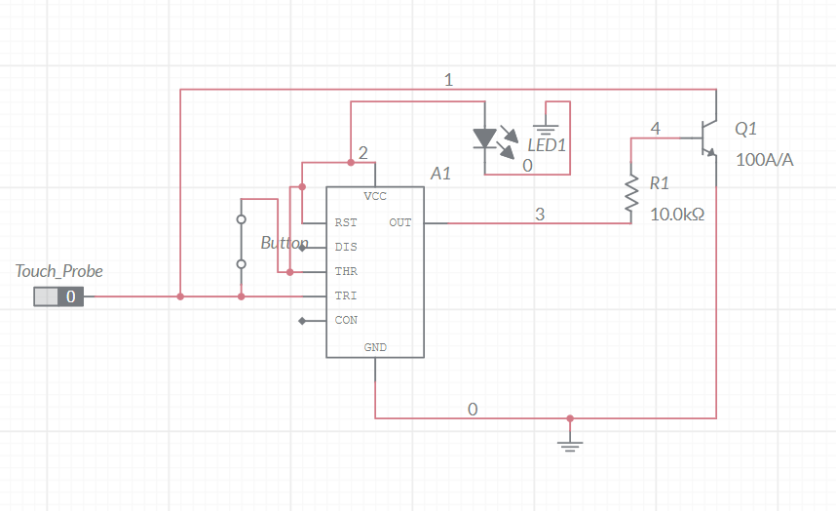
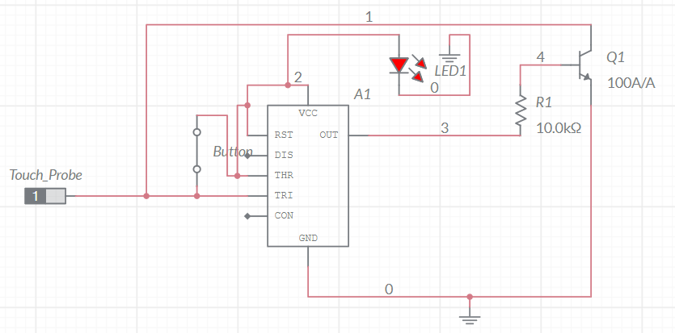
Circuit
Fig:1 (Touch Probe no Contact)
Fig:2 (Touch Probe Get Contact)

Slide 5
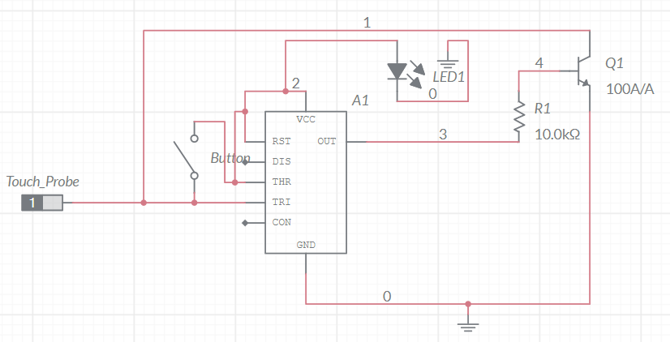
Fig:3 (Button Is pushed)

Slide 6
Thank YOU

